Slide 1

Data Analysis & Visualisations of IPL
Nithin Veer Reddy | Mohan Dwarampudi |Abhinivesh Palusa | Lokin Sai

Slide 2
MOTIVATION
The art and practice of visualizing data is becoming ever more important in bridging the human-computer gap to mediate analytical insight in a meaningful way. ―Edd Dumbill

Slide 3





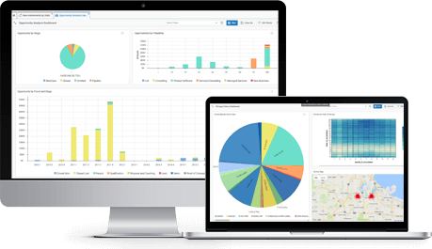



Pipeline
Raw Data
http://bdaipl.tech

